Slide 1

Introduction to OAuth 2.0 & OpenID Connect
Rifaat Shekh-Yusef
Director, Identity & Cybersecurity @ EY
Chair of OAuth WG @ IETF
17 April, 2024

Slide 2
OAuth 2.0
An IETF open standard that defines a delegation framework.
Allows an end user to grant an application access to their resources without sharing their credentials with the application.

Slide 3
OAuth Example Use Cases
Mint application access to a financial account on behalf of the end user.
Application issues tweets on behalf of an end user.
Application access Dropbox, Google Drive, etc, on behalf of an end user.

Slide 4
OpenID Connect (OIDC)
An OpenID standard that defines an identity layer on top of OAuth.
Allows an application to verify the identity of an end user based on the authentication performed by an authorization server.

Slide 5
OIDC Example Use Cases
User login to ChatGPT by authenticating to Auth0.
User login to ChatGPT by authenticating to Google through Auth0.

Slide 6
Demo Use Cases
User login to an application using Auth0.
User login to an application using AWS Cognito.
User login to an application using a Auth0 with federation to Google account.
An application accessing an API on behalf of the user.

Slide 7
Definitions
Authentication
A process that verifies the identity of a user/entity.
Authorization
A process that controls user/entity access to resources.

Slide 8






OAuth 2.0 Framework Overview
AS
RS
RO
Client
Note: The icons used in this presentation are courtesy of identicons.dev

Slide 9
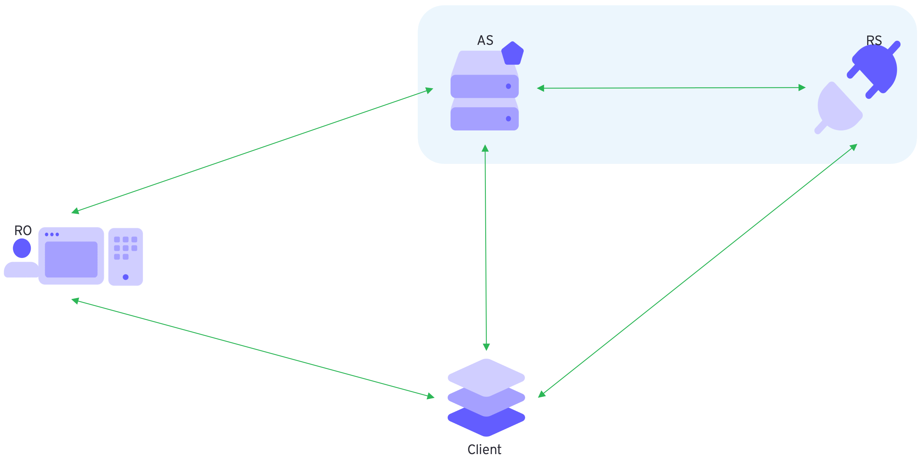
Parties
Resource Owner (RO)
The end user trying to login to an application or trying to grant an application access to some protected resources.
User Agent (UA)
Client programs that initiate a request on behalf of the end user. For example, a browser, a mobile app, etc.
Authorization Server (AS)
The server issuing tokens to the Client after authenticating the end user.
Resource Server (RS)
The server hosting the API that providers access to the protected resources.
Client/App
The application accessing the protected resources on behalf of the end user.

Slide 10
Setup
To allow these entities to securely interact with each other and deliver the expected service, there is a need for some initial setup and/or configuration:
AS Domain/Tenant
RS/API
Client/App
User Store

Slide 11
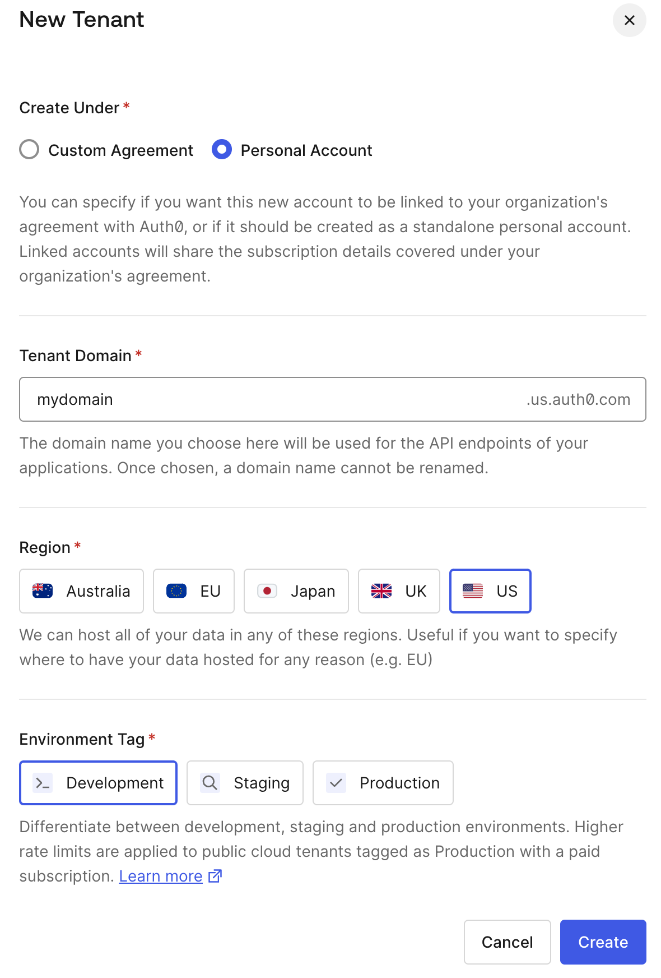
AS Domain/Tenant
The Authorization Server must be setup and configured with the proper domain name.
If it is a multi-tenant platform, then a new tenant must be created and configured with the proper domain name.

Slide 12
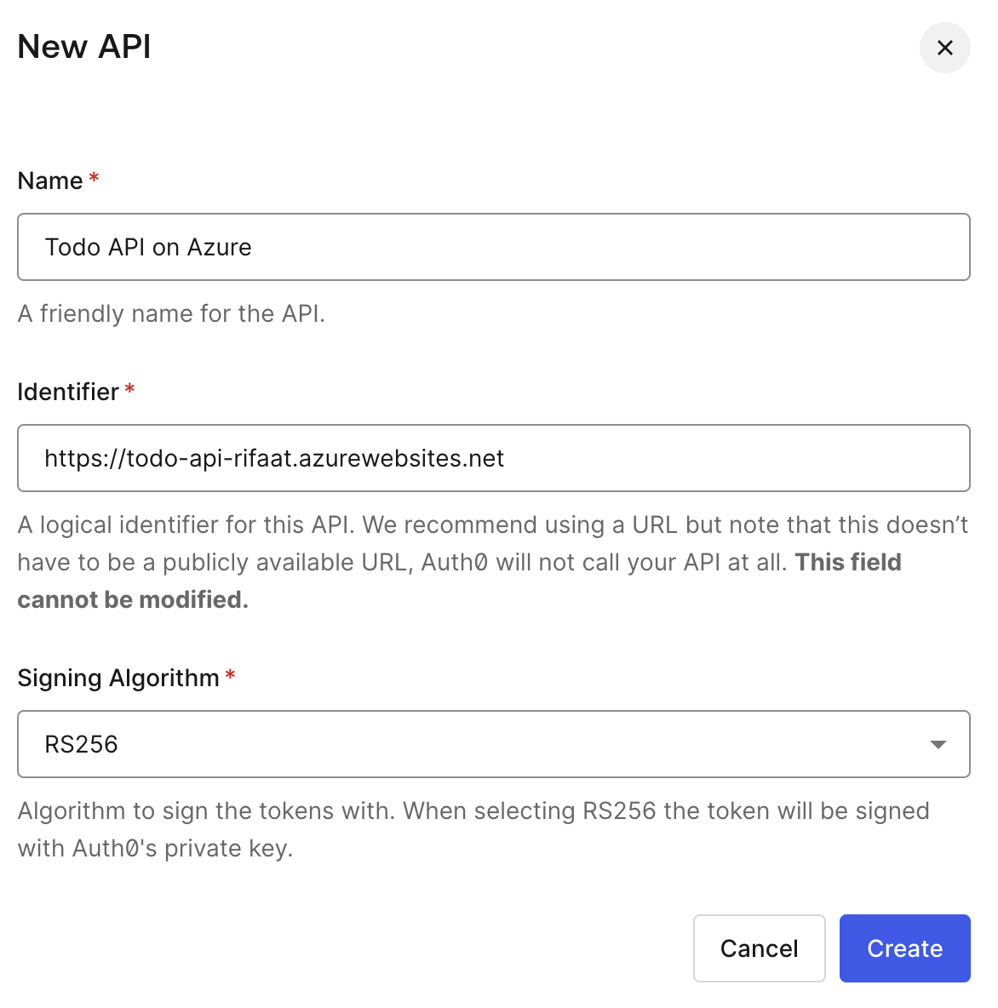
RS/API
The Authorization Server must be configured with the APIs it is expected to protect and issue tokens that allow access to these APIs.

Slide 13
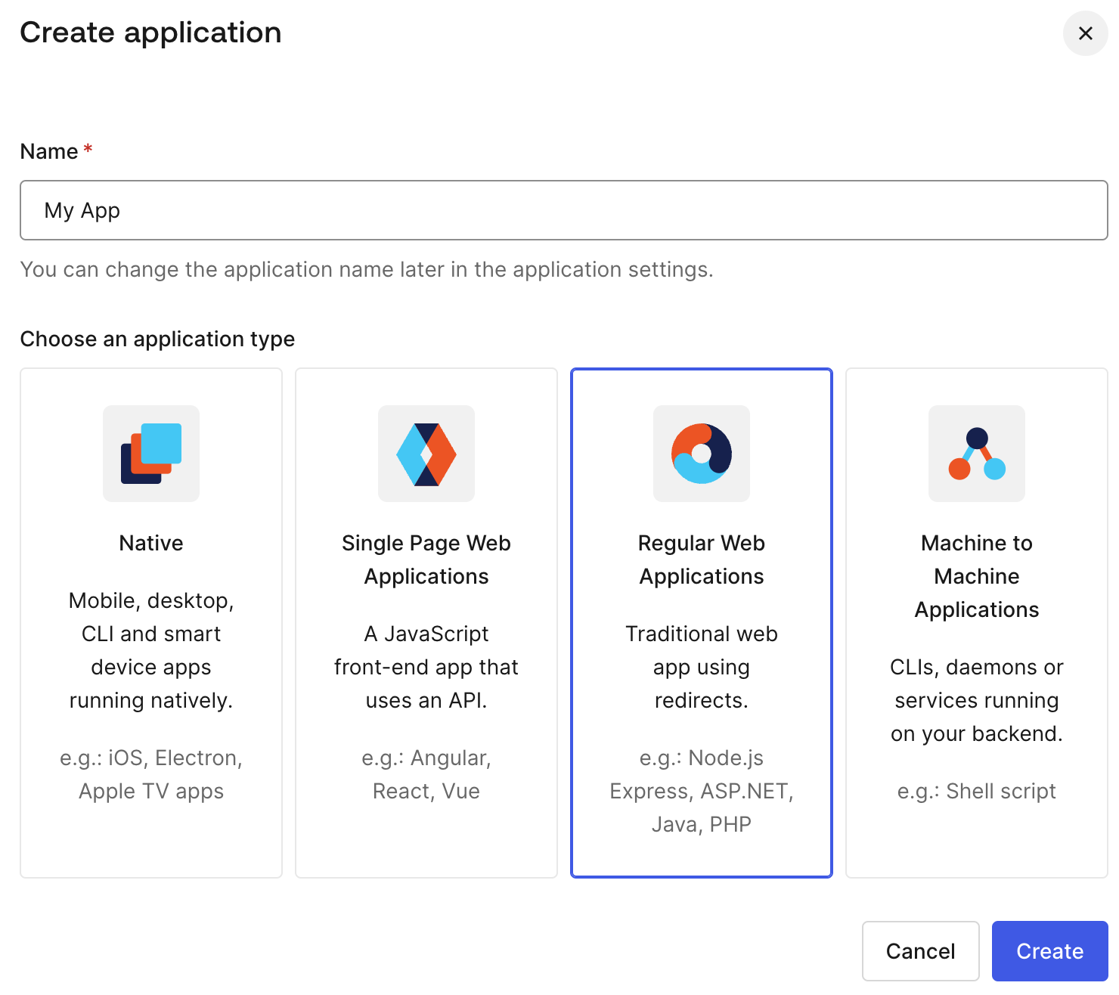
Client/Application
The Application must be first registered with the Authorization Server to be able to request tokens and allow access to APIs on behalf of the user.

Slide 14
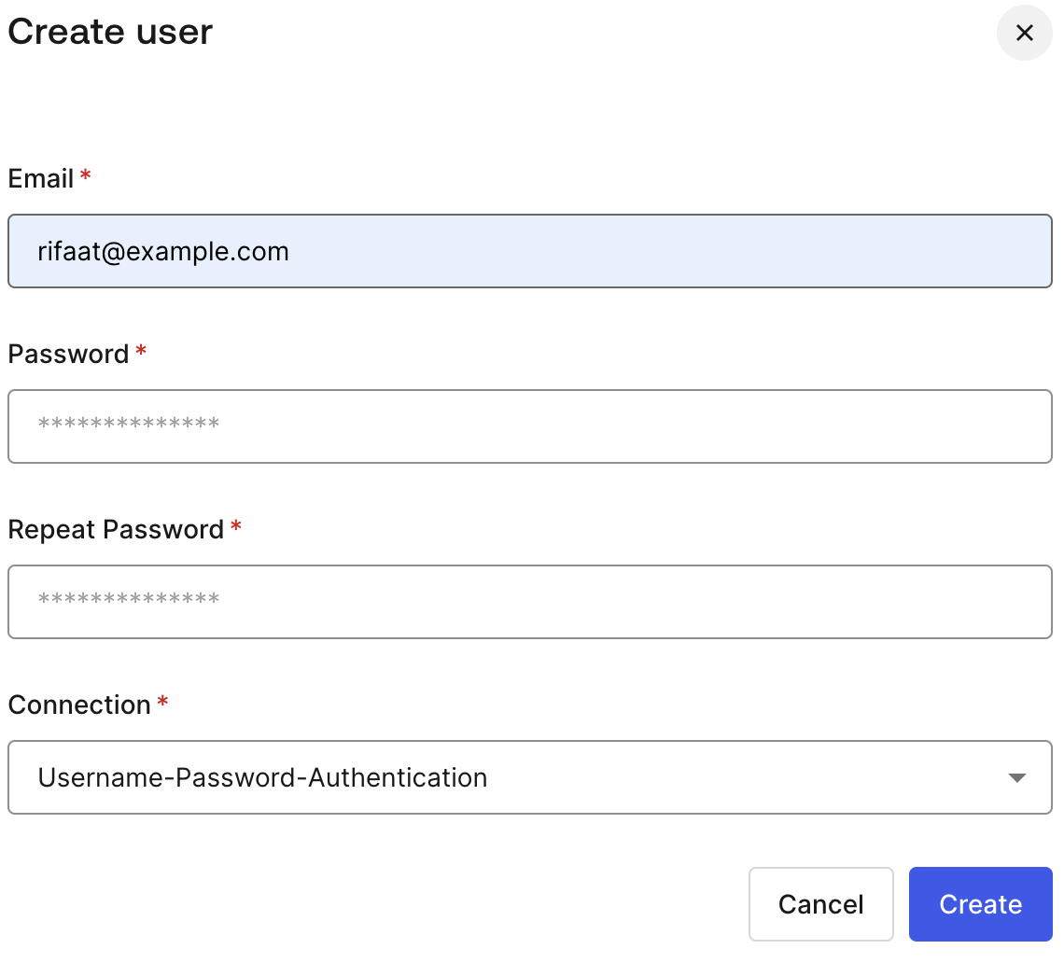
User Store
To allow users to authenticate to the Authorization Server and login to the application, the user must be added to a User Store, or the tenant is connected to an existing User Store.

Slide 15
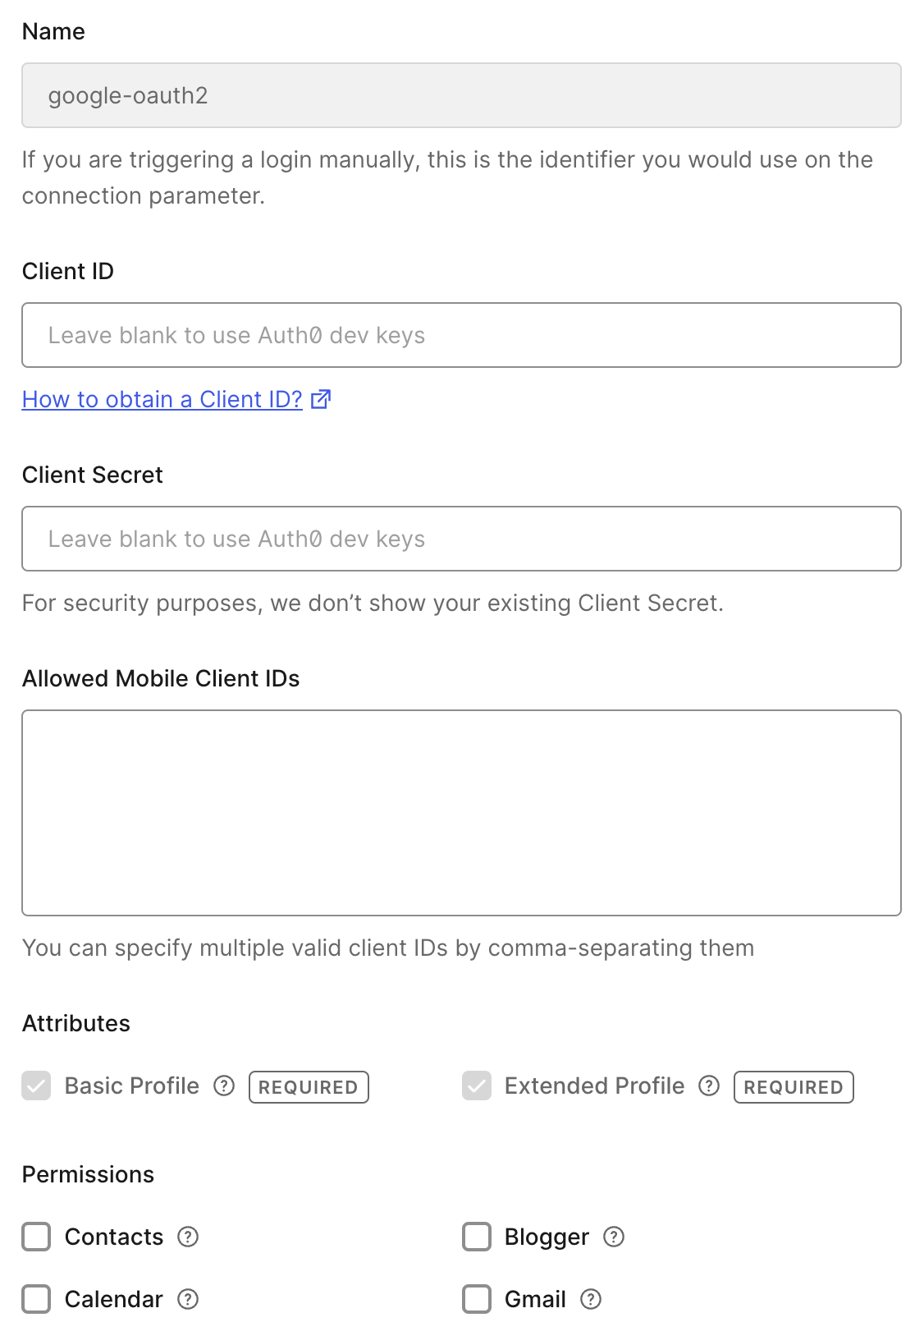
Social Connection
To allow users to authenticate to the Authorization Server and login to the application using their existing Google account, a new social connection must be created.

Slide 16
AS OAuth 2.0 Endpoints
The Authorization Server exposes the following OAuth 2.0 HTTP endpoints:
Authorization Endpoint
Used by the Client to obtain authorizations granted by the end user.
Token Endpoint
Used by the Client to exchange the granted authorization for Access Token.
There are other endpoints that will be discussed in future presentations, e.g., Introspection Endpoint, Discovery Endpoint, etc.

Slide 17
AS OpenID Connect Endpoint
The Authorization Server exposes the following OIDC HTTP endpoint:
UserInfo Endpoint
Used by the Client to obtain Claims about the authenticated user from the Authorization Server. The request to this endpoint must include an Access Token obtained previously by the Client from the Authorization Server.

Slide 18
Client OAuth 2.0 Endpoints
The Client exposes the following HTTP endpoints:
Redirection Endpoint
Used by the Authorization Server to return the granted authorization to the Client via the Resource Owner user agent, e.g., browser.

Slide 19


OAuth Tokens
Access Token is a credential issued by the Authorization Server and used by the Client to access protected resources on a resource server.
Refresh Token a credential issued by the Authorization Server and used by the Client to obtain access tokens from an Authorization Server.

Slide 20

OpenID Connect Token
ID Token is a credential issued by the Authorization Server and used by the Client to login a user to an application.

Slide 21
Token Data Structure
Reference
An identifier, usually a random string, that is used to retrieve the token details, usually through an introspection process.
Structured
A self-contained structured object that contains the token details, which usually does not require an introspection process.

Slide 22
Token Types
Bearer Token
A token that could be used by whoever holds the token.
Sender-constraint Token
A token that is constrained to a specific entity, via a proof-of-possession mechanism.
The entity using the token must prove that it holds a specific key to be able to use the token.
OAuth 2.0 Demonstrating Proof of Possession (DPoP)
https://datatracker.ietf.org/doc/rfc9449/

Slide 23
JSON Web Token (JWT)
A compact, url-safe mechanism, to represent claims to be transferred between two parties.
A claim is asserted information about a subject, e.g., end user, represented as a name/value pair.

Slide 24
JWT Structure
JWT
Header
{
"alg": "HS256",
"typ": "JWT"
}
{
"sub": "1234567890",
"name": "John Doe",
"iat": 1516239022
}
Payload
Signature
HMACSHA256(
base64UrlEncode(header).base64UrlEncode(payload),
secret key)

Slide 25
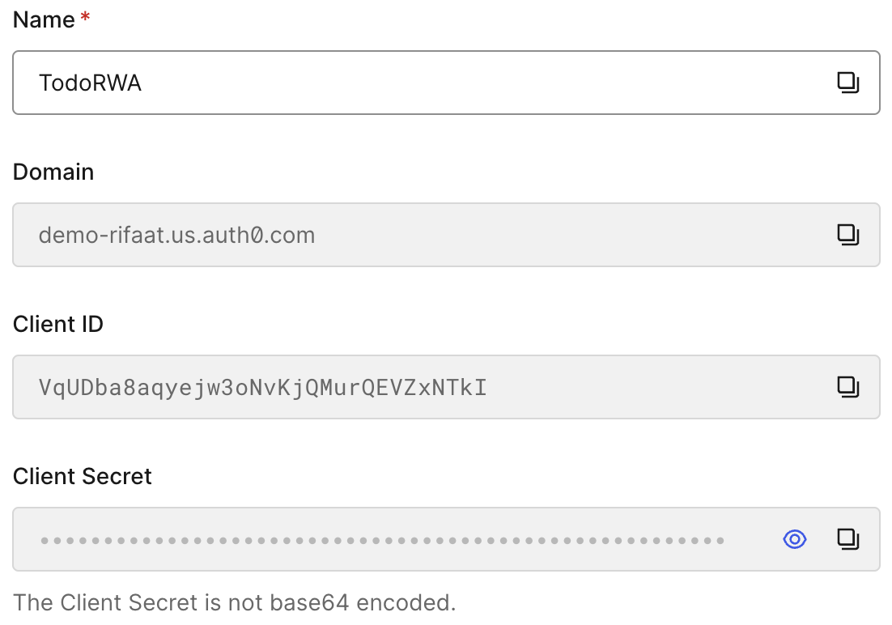
Regular Web App Registration
Domain
The domain of the tenant at the authorization server.
Client ID
A unique id allocated by the authorization server.
Client Secret
A unique client secret allocated by the authorization server.

Slide 26
Authorization Code Flow – Overview
AS
RS
4. 302 Client/callback?code
3. GET authorize
6. POST AS/token [code]
RO
5. GET callback?code
2. 302 AS/authorize
7. 200 [Tokens]
1. GET /login
8. GET /resource [Access Token]
9. 200 [data]
Client

Slide 27
Authorization Code Flow – Initiate Login
AS
RS
RO
GET /login HTTP/1.1
Host: localhost:8000
User-Agent: Mozilla/5.0 (Macintosh; Intel Mac OS X 10.15; rv:122.0)
Client

Slide 28
Authorization Code Flow – Redirection to AS
AS
RS
HTTP/1.1 302 Found
Date: Thu, 08 Feb 2024 15:22:56 GMT
Server: WSGIServer/0.2 CPython/3.12.1
Content-Type: text/html; charset=utf-8
Location: https://demo-rifaat.us.auth0.com/authorize?
response_type=code&
client_id=VqUDba8aqyejw3oNvKjQMurQEVZxNTkI&
redirect_uri=http%3A%2F%2Flocalhost%3A8000%2Fcallback&
scope=openid+profile+email&
state=UXjJIFf4Cbo9b8PlrwSXhH2OFMi4l5&
audience=https%3A%2F%2Ftodo-api-rifaat.azurewebsites.net&
nonce=zXPz9zzZoVIPIWooOQwA
RO
Client

Slide 29
Authorization Code Flow – AS Authorization Endpoint
AS
RS
GET /authorize?
response_type=code&
client_id=VqUDba8aqyejw3oNvKjQMurQEVZxNTkI&
redirect_uri=http%3A%2F%2Flocalhost%3A8000%2Fcallback&
scope=openid+profile+email&
state=UXjJIFf4Cbo9b8PlrwSXhH2OFMi4l5&
audience=https%3A%2F%2Ftodo-api-rifaat.azurewebsites.net&
nonce=zXPz9zzZoVIPIWooOQwA HTTP/1.1
Host: demo-rifaat.us.auth0.com
RO
Client

Slide 30
Authorization Code Flow – Redirect to App
AS
RS
HTTP/1.1 302 Found
Date: Thu, 08 Feb 2024 15:39:58 GMT
Content-Type: text/html; charset=utf-8
Content-Length: 288
Connection: keep-alive
Location: http://localhost:8000/callback?
code=xvq9NX0ipGNygs4W8VVVxy4EQY1fNJMtCtq5TYwvw97Ds&
state=UXjJIFf4Cbo9b8PlrwSXhH2OFMi4l5
RO
Client

Slide 31
Authorization Code Flow – App Redirection Endpoint
AS
RS
RO
GET /callback?
code=xvq9NX0ipGNygs4W8VVVxy4EQY1fNJMtCtq5TYwvw97Ds&
state=UXjJIFf4Cbo9b8PlrwSXhH2OFMi4l5 HTTP/1.1
Host: localhost:8000
Client

Slide 32
Authorization Code Flow – AS Token Endpoint
AS
RS
POST oauth/token HTTP/1.1
Host: https://demo-rifaat.us.auth0.com
Accept: 'application/json'
Content-Type: 'application/x-www-form-urlencoded;charset=UTF-8'
{
'grant_type': 'authorization_code’,
'code': 'xvq9NX0ipGNygs4W8VVVxy4EQY1fNJMtCtq5TYwvw97Ds’
}
RO
Client

Slide 33
Authorization Code Flow – Complete Login
AS
RS
HTTP/1.1 200 OK
'Date': 'Tue, 13 Feb 2024 17:57:38 GMT',
'Content-Type': 'application/json',
"access_token": ”<access token>",
"id_token":”<id token>",
"scope":"openid profile email todo:add todo:delete todo:read todo:update",
"expires_in":86400,
"token_type":"Bearer"
RO
Client

Slide 34
API Call
AS
RS
RO
GET api/list HTTP/1.1
HOST: https://todo-api-rifaat.azurewebsites.net
Authorization: 'Bearer <access token>'
Client

Slide 35
API Response
AS
RS
HTTP/1.1 200 OK
'Content-Type': 'application/json',
{
"message":[
{"id": 1, "title": "IETF Conference", "description": "Call for topics", "complete": false},
{"id": 2, "title": "Project", "description": "Complete the login module", "complete": false},
{"id": 3, "title": "Groceries", "description": "Milk Eggs Banana Bread", "complete": false}]
}
RO
Client

Slide 36
DEMO
Auth0/Cognito
TODO API/Render
RO
App/laptop

